Slide 1
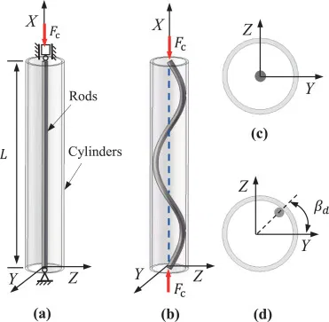

(Z)
(Y)
r
(X)
R
t
(X)
(b)
(Y)
(a)

